Slide 1
Facial Emotion Recognition on Vision Transformer.
Project of Machine Learning A.A. 2021/22
Andrea Gurioli & Mario Sessa

Slide 2
Summary
Introduction
Datasets
Data Integration
Data Analysis
Preprocessing
Experiments
Sharpness-Aware Minimizer
Evaluation
Face Detection
Demo

Slide 3
Introduction
Facial Emotion Recognition (FER) is a classification problem based on facial detection in an immersive environment when ambiguous emotions are the cornerstone of the problem.
The focus of our project is to analyze how the Transformers (ViT) perform on this specific task and compare them with a state-of-art model.
Furthermore, we will test Vision Transformers on a small dataset, and we will try configuring some hyperparameters to optimize results.

Slide 4
Datasets
We use three datasets:
FER-2013: Gray-scaled images on seven classes of emotions.
CK+48: A subset of the original dataset formed by well-aligned images on seven classes.
AffectNet: A subset of original AffectNet images on eight classes in RGB format.
Classes are contempt, disgust, fear, surprise, happy, sad, neutral, and angry.
CK+48 and FER-2013 don’t have any samples about contempt class.
Unfortunately, CK+48 and AffectNet are not fully available for students. Hence, the first challenge is integrating the open-sources dataset together and uniforming them in a well-formatted result dataset.

Slide 5
Data Integration
The integration phase merges the three datasets described in the previous slide into one.
FER-2013 and CK+48 are presented only in the Training set.
AffectNet is distributed between training, validation, and testing set.
According to the lower number of samples related to the class distribution, we divided AffectNet samples to obtain balanced testing and validation set. The “residual samples” are put in the training set.
The training set is unbalanced in this phase. We will use data augmentation to balance the number of samples around classes.

Slide 6
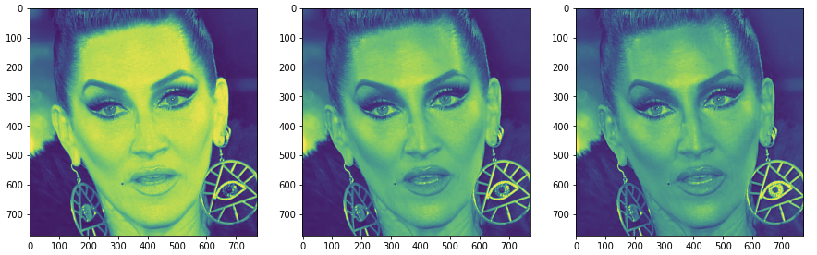
Data Analysis
The analysis of data is split in:
Analysis of Original Datasets (AffectNet, FER-2013, CK+48)
Analysis of the result dataset (called AVFER)
We showed some experiments on images, and we analyzed pixel values, number of samples, channel distribution, format, and size of images.

Slide 7
Preprocessing
We executed three different tasks to prepare the dataset for the training phase.
Channels adaptation on three values (RGB) for every image of the result dataset.
Format changing in jpg format
Data augmentation on the training set to obtain 20.000 samples per class.
The resulting dataset is stored in a copy of AVFER called VFER.

Slide 8
Data Augmentation
During the data augmentation, we used the following techniques:
Zoom Augmentation: Zoom in or zoom out of the images in a zoom range maximum with a value of 0.6.
Image Rotation: Rotation of images of 10 grades to change the perspective of the faces.
Random Shift: Shift the image horizontally and vertically for a maximum of 20% of the total width and height.
Brightness Augmentation: Changing pixels values to modify the brightness around 0.2 and 0.6 values.
Images generated are proportional to the original number of class samples, and we used the Image Generator class from Keras to archive it.

Slide 9
Experiments
We test our generated dataset on 2 different pre-trained models:
ResNet-18: ResNet version with 18 layer deep. 11M of parameters
ViT-B/16: Transformer with 16x16 patching embedding. 86M of parameters.
We propose different configuration for the fine-tuned ViT-B/16 model. We tried to adapt the training using gradual learning rate and choose different iterative optimization algorithms like SGD (Stochastic Gradient Descendant) and SAM (Shapeness-Aware Minimizer that works well with small datasets).

Slide 10
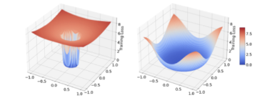
Sharpness-Aware Minimizer (SAM)
It is an optimization algorithm based on smoothing the loss landscape and reducing its Hessian eigenvalue.
During the training phase, it chooses values about the lower neighbors-related loss value and not the lower on the individual basis as SGD does.
The SAM usage on transformers works well with small and noisy datasets like our case, according to [5] and [6].
Cross-entropy loss landscape on ImageNet with SGD (left) and SAM (right).

Slide 11
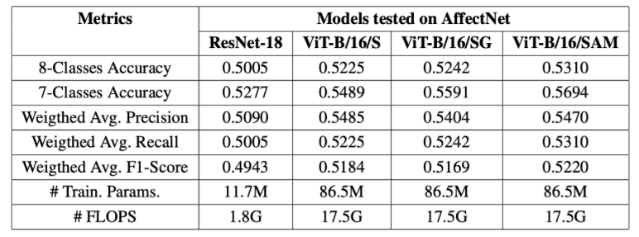
Evaluation

Slide 12
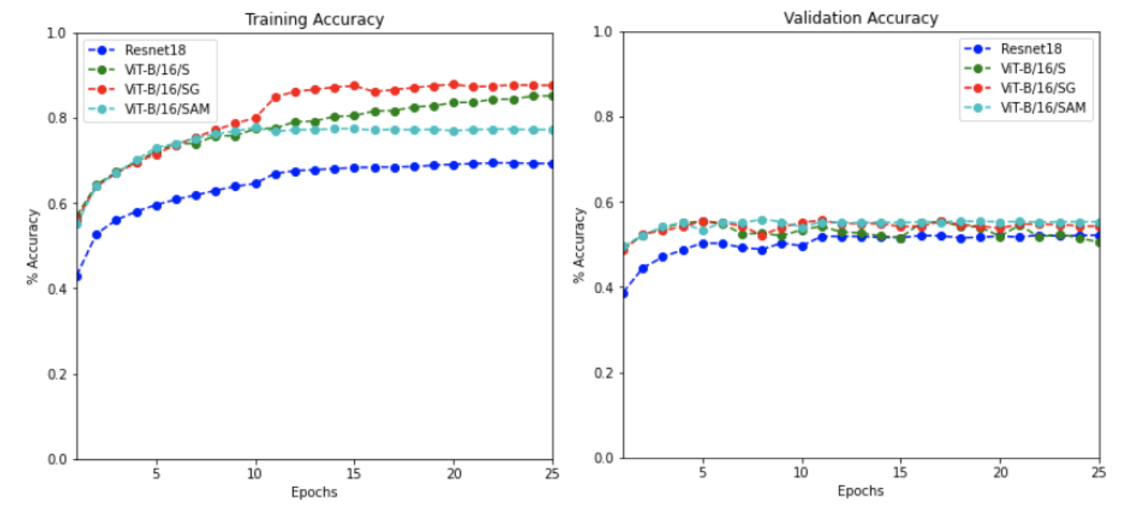
Evaluation, Accuracy
Image shows how training and evaluation accuracy changes over time for the proposed configurations of ViT-B/16 and for ResNet-18. The main differences are related to the gradual learning rate usage on the transformers that gives a gradual training accuracy increment in a regular curve, meanwhile the validation accuracy obtains an initial increment and, then, reach the plateau around 55%, even for ResNet-18 model

Slide 13
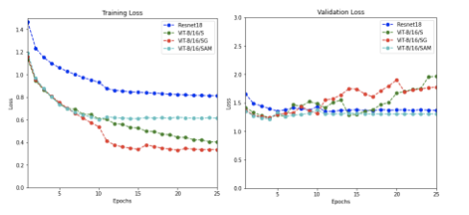
Evaluation, Loss
Image shows how training and validation loss changes over proposed Vision Trans- formers configurations and compares them with the ResNet-18 behavior. According to the plots, ResNet-18 maintains the high training loss over times compared to ViT configurations. Validation loss of the SAM based ViT-B/16 obtains a similar behavior of ResNet-18 due to the smoothing of the loss landscapes which performs well for small dataset as our case.

Slide 14
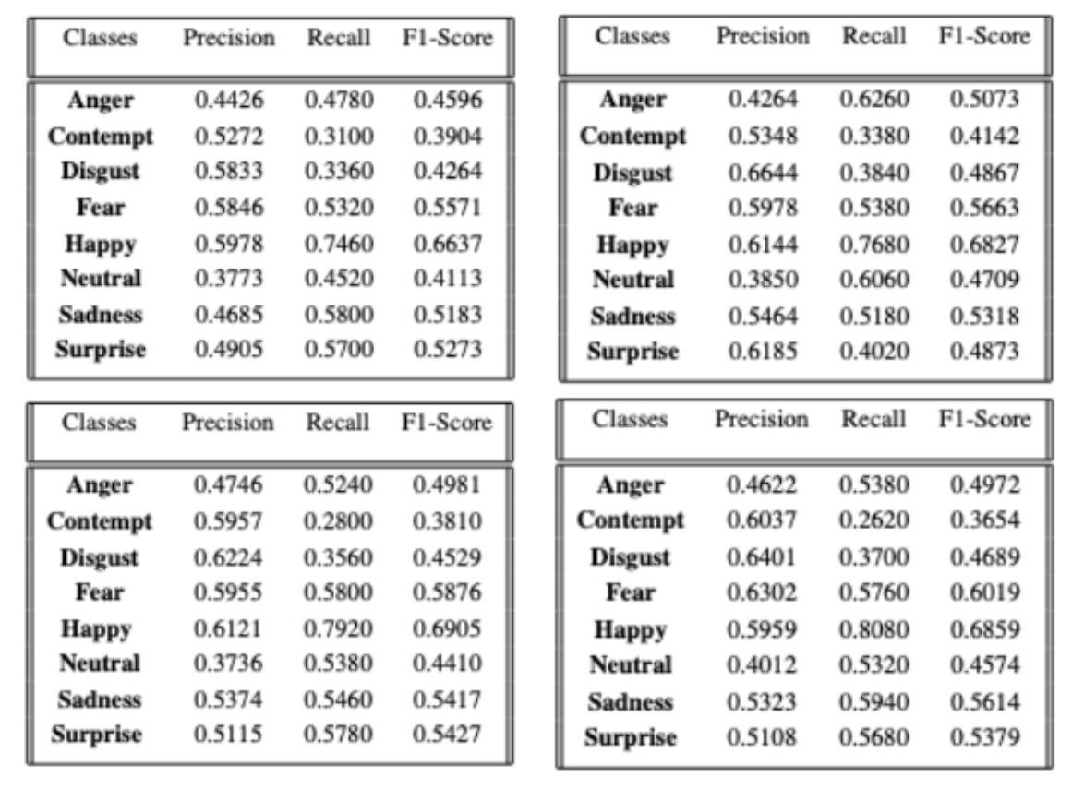
Evaluation, Classes Metrics
Precision, Recall and F1-Score divided for classes on each model. ResNet-18 (left-up), ViT-B/16/S (right-up), ViT-B/16/SG (down-left) and ViT-B/16/SAM (down-right).

Slide 15
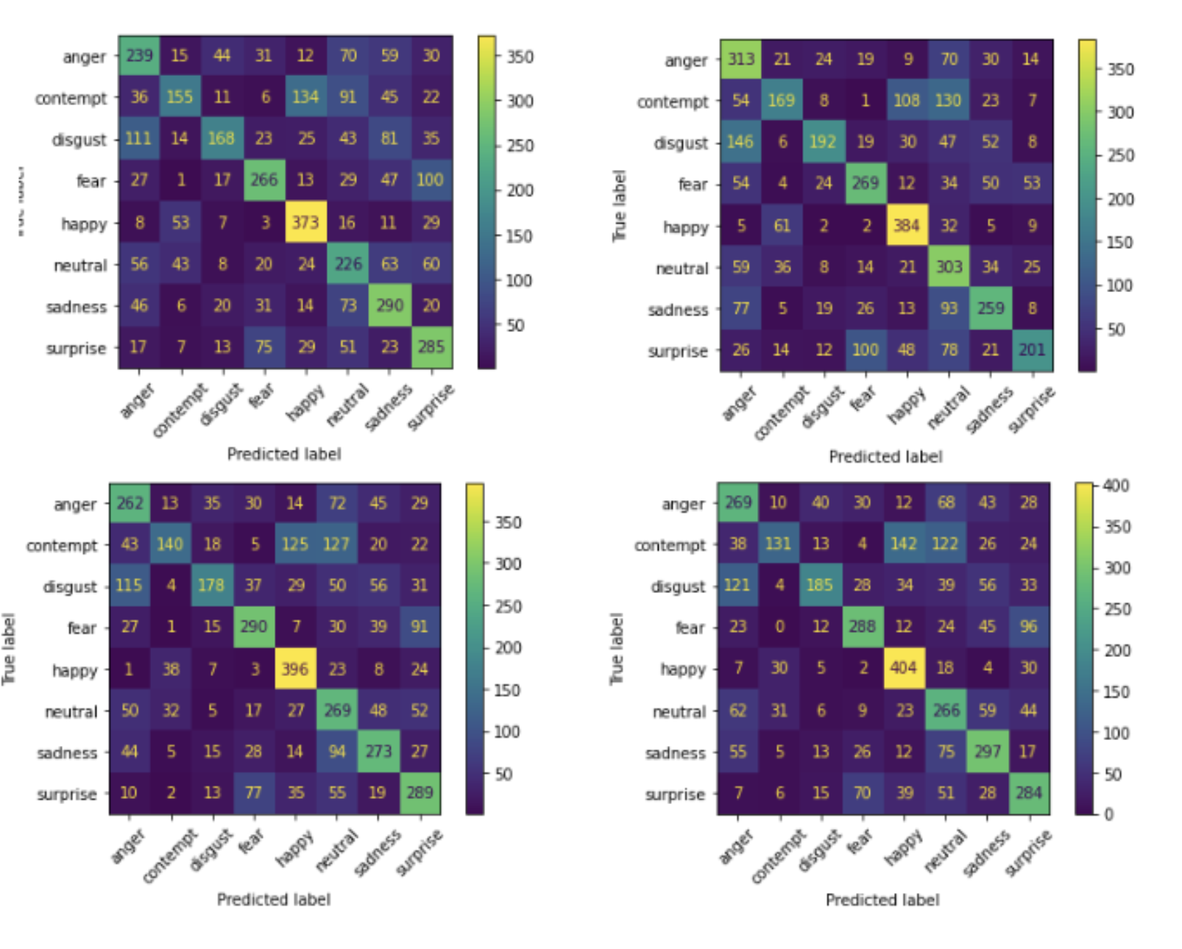
Evaluation, Confusion Matrix
Confusion Matrices of models on testing set. In order: ResNet-18 (left-up), ViT-B/16/S (right- up), ViT-B/16/SG (down-left) and ViT-B/16/SAM (down-right).

Slide 16
Face Detection
We used Single-Shot Detection (SSD) model as a black-box for the face detection.
We downloaded a pre-trained configuration to detect faces in a frame of the video generated by the captured webcam streaming and crop the face to prepare the input for ViT-B/16 or ResNet-18 models.
Due to the differents of number of parameters (11M for ResNet-18 and 65M for ViT-B/16), the real-time application results to be slower for the ViT-B/16.

Slide 17
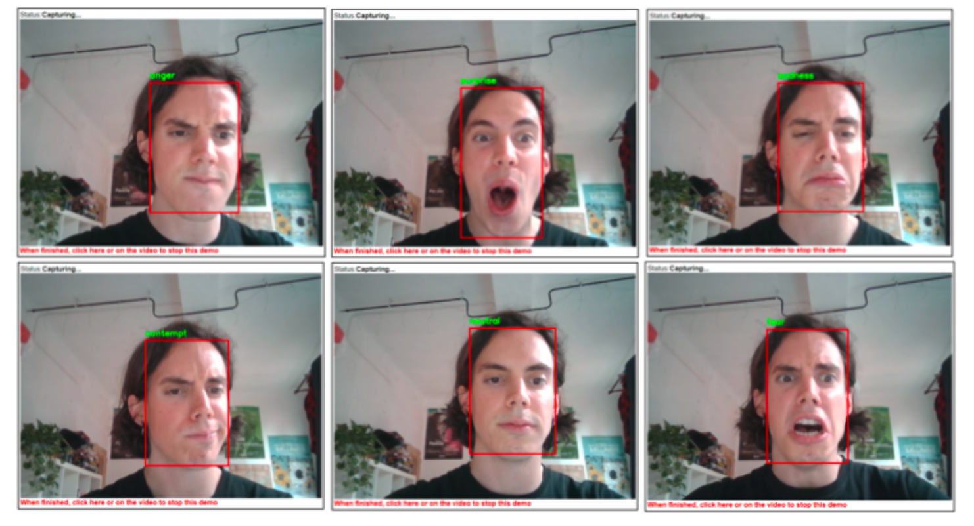
Demo

Slide 18
References
Attention is all You Need, Ashish Vaswani and Noam Shazeer and Niki Parmar and Jakob Uszkoreit and Llion Jones and Aidan N. Gomez and Lukasz Kaiser and Illia Polosukhin.2017
An Image is Worth 16x16 Words: Transformers for Image Recognition at Scale, Dosovitskiy, Alexey and Beyer, Lucas and Kolesnikov, Alexander and Weissenborn, Dirk and Zhai, Xiaohua and Unterthiner, Thomas and Dehghani, Mostafa and Minderer, Matthias and Heigold, Georg and Gelly, Sylvain and Uszkoreit, Jakob and Houlsby, 2021
SSD: Single Shot MultiBox Detector, Wei Liu and Dragomir Anguelov and Dumitru Erhan and Christian Szegedy and Scott Reed and ChengYang Fu and Alexander C. Ber, 2016
When Vision Transformers outperform ResNets without Pre-training or Strong Data Augmentation, Xiangning Chen, Cho-Jui Hsieh, Boqing Gong, March 2022
Sharpness-Aware minimization for Efficiently Improving Generalization, Pierre Foret, Ariel Kleiner, Hossein Mobahi, Behnam Neyshabur, Apr 2021
Deep Residual Learning for Image Recognition, K.He, Kaiming and Zhang, Xiangyu and Ren, Shaoqing and Sun, Jian, 2015
Facial Expression Recognition with Visual Transformers and Attentional Selective Fusion, Fuyan Ma, Bin Sun and Shutao Li, Fellow, Feb 2022
A Survey of Vision Transformers, Xang Liu, Yao Zhang, Yixin Wang, Feng Hou, Jin Yuan, Jiang Tian, Yang Zhang, Zhongchao Shi, Jianping Fan, Zhiqiang He, May 2022

